Slide 1
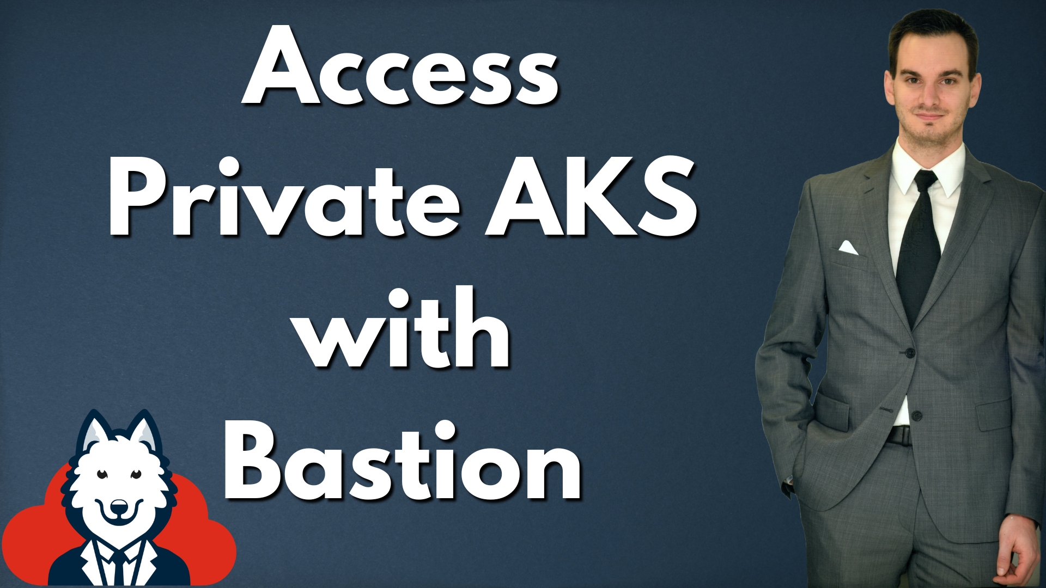

Slide 2
Agenda
Recap private AKS cluster
Quick introduction to Azure Bastion
Overview architecture
Configure access from VM via Bastion
Test setup

Slide 3
Private AKS Cluster

Slide 4
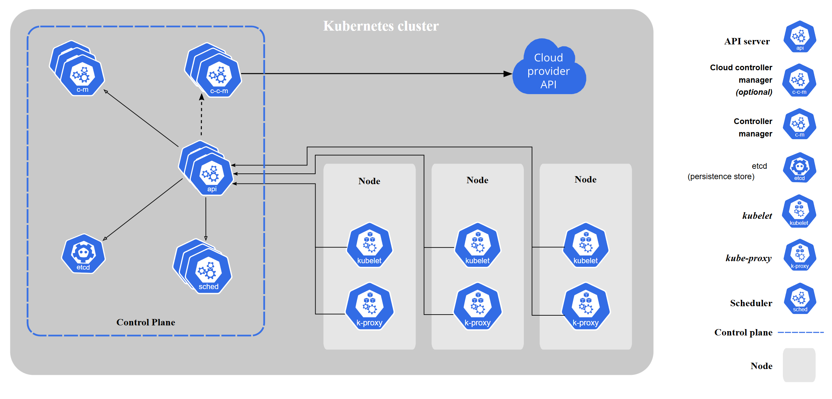
Source: https://kubernetes.io/docs/concepts/overview/components

Slide 5
Azure Bastion

Slide 6
Azure Bastion
Jump host

Slide 7
Azure Bastion
Jump host
Connect in Azure portal or via native client

Slide 8
Azure Bastion
Jump host
Connect in Azure portal or via native client
RDP and SSH

Slide 9
Azure Bastion
Jump host
Connect in Azure portal or via native client
RDP and SSH
Shareable links and session recording

Slide 10
Azure Bastion
Jump host
Connect in Azure portal or via native client
RDP and SSH
Shareable links and session recording
Bastion connects over private connection to VMs

Slide 11
Azure Bastion
Jump host
Connect in Azure portal or via native client
RDP and SSH
Shareable links and session recording
Bastion connects over private connection to VMs
Subnet named AzureBastionSubnet needed

Slide 12
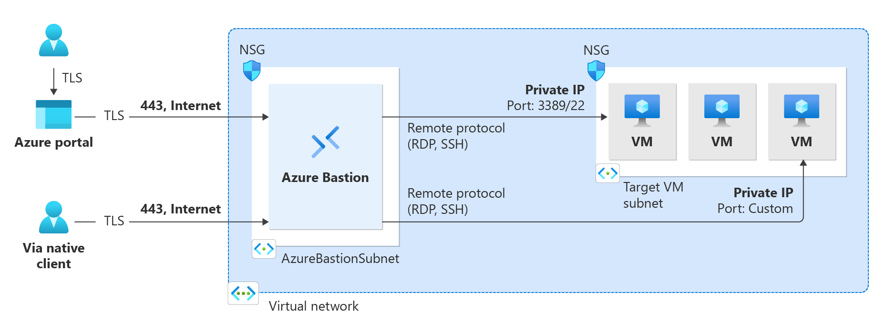

Slide 13
Private AKS Cluster with Azure Bastion

Slide 14
